Slide 1
Switch..Case
Lecturer: Nadia Binte Asif

Slide 2
Syntax
switch(expression){
case value1:
//code to be executed;
break; //optional
case value2:
//code to be executed;
break; //optional
......
default:
code to be executed if all cases are not
matched;
}
Alternate to if..else ladder
Allows to execute multiple operations for different possible values of a single variable → switch variable
Expression
Type: Char or integer
Multiple Cases
Type: Char or Integer
Break is not mandatory
No break statement → Matched? →executed

Slide 3
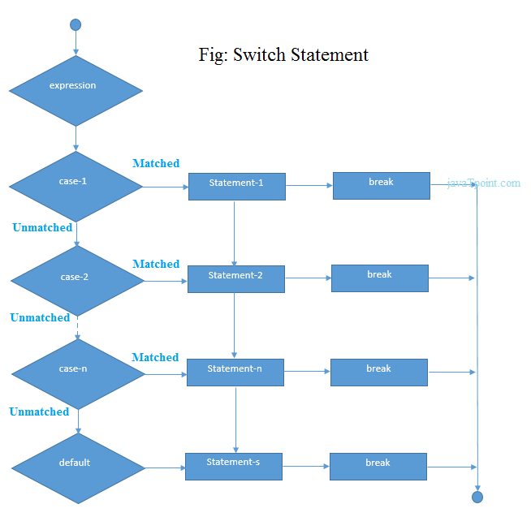

Slide 4
Examples
// Program to create a simple calculator
#include <stdio.h>
int main() {
char operation;
double n1, n2;
printf("Enter an operator (+, -, *, /): ");
scanf("%c", &operation);
printf("Enter two operands: ");
scanf("%lf %lf",&n1, &n2);
switch(operation)
{
case '+':
printf("%.1lf + %.1lf = %.1lf",n1, n2, n1+n2);
break;
case '-':
printf("%.1lf - %.1lf = %.1lf",n1, n2, n1-n2);
break;
case '*':
printf("%.1lf * %.1lf = %.1lf",n1, n2, n1*n2);
break;
case '/':
printf("%.1lf / %.1lf = %.1lf",n1, n2, n1/n2);
break;
// operator doesn't match any case constant +, -, *, /
default:
printf("Error! operator is not correct");
}
return 0;
}

Slide 5
SWITCH PARAMS
Default Keyword
Break Keyword
The default keyword specifies some code to run if there is no case match:
When C reaches a break keyword, it breaks out of the switch block.
This will stop the execution of more code and case testing inside the block.
When a match is found, and the job is done, it's time for a break. There is no need for more testing.
int day = 4; switch (day) { case 6: printf("Today is Saturday"); break; case 7: printf("Today is Sunday"); break; default: printf("Looking forward to the Weekend"); }

Slide 6

Problems
Write a C program to check whether an alphabet is vowel or consonant using switch case.
Write a C program to find maximum between two numbers using switch case
C program to print day of week name using switch case
Write a C program that finds the root of the following quadratic equation:

